Slide 1

Youth & Senior Game Cards

Slide 2

All Blacks
Overload Attack Focus
Rules
Focus
2 Defenders must retreat to their own line every time there is a touch situation
Attack
Make the extra players count
Attack best space, encourage creativity
Defence
Do not get beat through the middle
Scramble to connect to touchlines
Challenge
Overload Attack Tips
Can you break down the defence in your shape?
Coaching Superpower - Peer > Peer: Allow your players to troubleshoot themselves to solve their own problems
Play tight – be brave, making your decisions tight to the defensive line
Player square – all players with running intent through square hips

Slide 3

Globetrotters
Keep ball alive Focus
Rules
Attack
Must score within 1 phase
Score from a kick = restart with ball from middle of pitch
Defence
Complete 1 tackle to regain possession
Focus
Attack
Emphasis is on movement of the ball before contact keeping the ball alive.
Attack with kicking, encourage creativity
Defence
Stay connected to force attack to touchlines.
Challenge
Coaching Superpower
2nd ball: The perfect game to throw in a 2nd ball to aid with space and transition.
Player superpower
Allow 1 player per team to have more than one tackle to get some linebreaks.
Keep Ball alive Tips
Encourage support players to target their running to give ball carrier three passing options.
Ball Carriers need to make eye contact with their support players before offloading.

Slide 4

Storm
Momentum and Phase Focus
Rules
Attack
Must score within 6 phases
Can kick on 6th phase.
If ball goes out from kick opposition ball back where it was kicked.
Defence
3 dominant tackles = turnover
Focus
Attack
Emphasis is on momentum and speed of phases. Whilst using tactical kicking.
Defence
Choose when to blitz and when to slide.
Challenge
Coaching Superpower
Change how players play the ball after tackle to encourage different speed of attack.
Momentum and Phase Tips
Encourage players to scan for weaknesses in defense.

Slide 5

France
Ball Transfer Focus
Rules
Attack
3 Phases (Tags) to score
If you make 3 consecutive passes, the phase count re-starts
Defence
• Every phase the full defensive side must retreat onside and complete a "Down-Up"
Focus
Attack
﻿﻿Scan best space and attack it
﻿﻿Catch Pass Habits
﻿﻿Sharp play of the ball
Defence
• Work hard off the ball to "GET SET"
Challenge
Player Superpower
• Include TACKLE MONSTER superpower
Coaching Superpower
• FREEZE: stop play for 3-5 seconds to allow Players to scan the bigger picture
BALL TRANSFER TIPS
﻿﻿SPEED TO SET
﻿﻿FINGERS UP
﻿﻿CATCH EARLY
﻿﻿HANDS AT THE TARGET
﻿﻿KEEP MOVING UPFIELD

Slide 6

Fiji
Ball Transfer Focus
Game Description:
The attack must score within 3 phases or ball is turned over – 1 point per post contact offload
The attack must score within 3 phases or ball is turned over – 1 point per post contact offload
Focus
BALL CARRY: Run-Catch, Change Up, Pump Ball, Footwork, Fire Inside Leg Through, Covers On, Studs In, Dynamic Placement.
BALL SUPPORT: Speed to support
Challenge
Turnover if:
1. Toucher(s) can get to ground and back on feet before Attack support arrives at BD = Poor Ball Support
2. Poor Ball Carry/Presentation skill error or other Core 4 execution referees deem poor
Noticing: Is attack keeping tempo high with good core 4 skills, is defence winning the race to breakdown.
Nerd Alert example: Attack get a bonus point or steal a player from the opposition if they can perform an effective “Reverse”

Slide 7

Saints Rondo
Both sides of the Ball Focus
Game Description
1st Touch = Ball carrier keep going but can’t score.
2nd Touch = play stops and Attack must restart with another ball rolled behind them
- Forward pass, knock on = Attack must start with another ball.
-If attack score, they must play two passes from where they scored before they can score again.
Focus
Ball transfer playing the ball into best space whilst playing through and on top of attack.
Defence get to understand how to defend with less players and equal numbers. Speed to set.
Coach Superpower:
Keep the time of the game short and keep it intense. Keep the score to make sure game is competitive.
Nerd Alert example: A kick counts as a pass!
Challenge
1 point for a try and -1 point for every, 2 touch tackle and mistake.
Start with less defenders and add more.

Slide 8

Chiefs
Focus on Attacking off 9
Game Description:
First four phases must be played off the number 9 (one out rugby), any phase after can be played anywhere.
Defence Coaching Focus
-What is my role in the defence right now?
-How can we manipulate the attack play?
-Who am I defending, how can I be more effective?
-Organisation, communication, double hit?
Challenge in Attack
What is my role within this attack? Ball carrier, soft line, hard line, next phase organiser...
Positionally where do we need to play? Play around the corner, get to an edge, get back to the middle of the pitch...
How does the 9 like to play the ball? Pass from the base, pick and pass, pass and go...
Why use it?
Essential tools to use?
Encourage tactical thinking.
Freeze frames - highlight
Explore creative ways to attack off 9.
Group reflection - how could we get better
Develop self-organisation.

Slide 9

Wallabies
Ruck speed Game
Game Description:
Defence win turnover if attack don’t deliver ball within 5 seconds of contact
Defence Coaching Focus
Double shots
Dominate tackles
Target breakdown
Challenge in Attack
- Keep Ball Alive
Ball Carry
Continuity
Breakdown (Speed to support)
Why use it?
Essential tools to use?
Encourage Attack to play quickly
Attack best space? Isolate defenders
Defence must think how to slow play down

Slide 10

Springbok
Overload Game
Game Description:
Defence is not allowed to fold (move to far side of breakdown) when there is a low touch made
Defence Coaching Focus
What do we do when we are numbers down?
What do we do off an edge?
What is my role after the ball moves from a ruck?
. Why use it?
Essential tools to use?
Creates different pictures for defence and attack
Challenges decision making boths sides of the ball
Develops scanning in attack
If players can stay square to hold the defence and achieve regular success.
Challenge in Attack
- Decision making
- Work around the corner after a touch to create overloads

Slide 11

Samoa
Decision making Game
Game Description:
5 touches = Turnover
1 touch offload – 2 touch must fall and lift ball from floor
Defence get turnover if they can stop attack within 2 passes
Defence Coaching Focus
Line speed
Double shots
Why use it?
Attack don’t have unlimited touch’s.
Encourages attack to scan for space across the pitch.
Encourages defence to come forward and force skill errors by reducing time and space.
Call Freeze and give teams 30 seconds for Peer-to-peer coaching to problem solve how to score.
Challenge in Attack
Ball Movement
Decision making
Continuity

Slide 12

Scotland
Continuity Game
Game Description:
1st Touch offload/Fall North Pop
2nd Touch offload/Fall North Pop
3rd Touch Fall North Present – contest at the breakdown
Defence Coaching Focus
- Defence can prevent offloads/lifts to force good decision making around lifts.
. Why use it?
Use 2nd Ball superpower to keep the game flowing from turnovers
Great opportunity to coach support play and roles. If we can keep the ball alive it does not allow the defence to get set which provides better attacking opportunities.
Challenge in Attack
- How can we best support the ball carrier?
- Where, when and how to pop the ball?

Slide 13

Brumbies
Continuous Defence Game
Game Description:
3 Teams – 1 Constantly in the middle defending the others start on each try line
After score or turnover defending team turn and defended the other attack team
- Add Rules to suit the needs of the players
Defence Coaching Focus
-Hard work off the ball
-Test our defensive decision making under pressure
. Why use it?
Technical -Tactical - Physical - Personal
Why not try…
If Defence get a turnover, they have 1 phase to score before the other gets the ball to work on transitions.
Challenge in Attack
Scan Defence before they are turned and attack best space
We other team is attacking can we problem solve to find opportunities to attack?

Slide 14
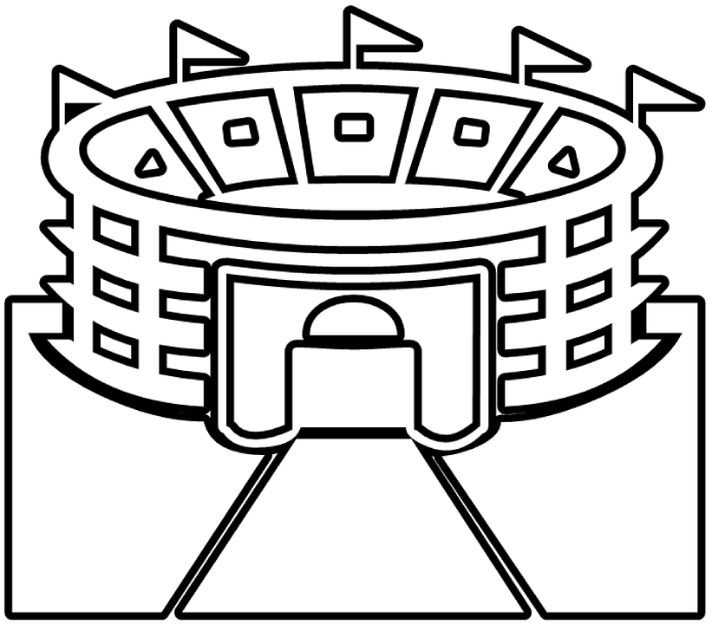
Ravenhill
Tactical Game
Game Description:
Pitch set up with a line across the middle
Attack has 3 phases to get over the line
If they get over the line, they then have unlimited phases to try score
If they don’t then they must kick to exit. Box kick, spiral bomb, punt etc (Ball must stay in play)
Defence Coaching Focus
How can we stop attack in 3 phases?
Line speed? Doubles?
Back field cover?
Transitions on Kick
Challenge in Attack
How can we use our 3 Phases wisely to get out of our half
On our Exit how can what type of kick will work best?
Why use it?
Essential tools to use?
Helps develop tactical knowledge around areas to play in and how to Exit.

Slide 15
Turnover Game
Transitional Game
Game Description:
Any turnovers in the game the direction of the pitch changes.
3 seconds before play restarts.
Transition Coaching Focus
Work hard for 3 secs to get set.
Close space (defence)
Challenge in Attack
Why use it?
Game is chaotic.
Encourages scanning.
Work rate to get organised
Work hard for 3 secs to get set.
Scan get ball to space (attack)

Slide 16
Guess The Rules
Self Organisation Game
Game Description:
Give the players the pitch dimensions.
Give the players the level of contact.
Can give players certain rules to help the game flow.
Secret rules can link to session focus.
Coach refs the game no coaching
Self-Organisation
To figure out the rules the players need to communicate with there team mates to find out what works.
As they work out the rules players will strategise their game plan as they figure out the rules.
Challenge in Attack
Can The attack figure out the rule before the opposition?
How do we give Information Effectively with High Turnovers?
Why use it?
Encourages players to engage with each other. Lots of peer to peer feedback

Slide 17
Game Constraints
Attack
Must play from 9/10
Must get into phase attack shape from 9 or 10
Ball carrier must have inside/outside/STAR option
Ball must be delivered in X seconds
Must get X passes before contact
Certain number of phases/time to score or get to another zone
Must win breakdown with X players
Incentives for 3 passes, offloads, kick to collect, scoring zones etc
Defence
Must have X players in backfield at all times
X players must be out of the game on their knees at each breakdown
If 10,20,30 is set before ball is delivered – Defence will get ball back
X players must retreat to their own line after each phase
Defence can’t enter certain areas of pitch
Incentives for low tackles, stopping attacks, slowing ball etc
Can we change the PITCH SHAPE or add ZONES?

